Slide 1

Studio: Unintentional Good
A4:
CONCEPT
VIDEO &
EXPLORATION

Slide 2
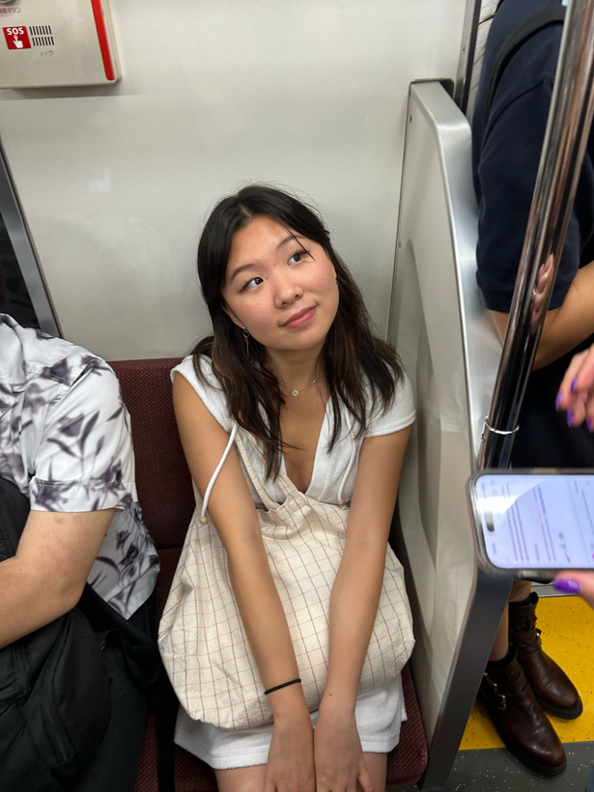


The Team
Emily Deng
Jenna Kim
Ariane Lee
Ariane Lee
Computer Science ‘25
Computer Science ‘25
Symbolic Systems ‘25
Computer Science ‘25

Slide 3
What's Inside
01 | Name
02 | Problem & Solution
03 | Market Research
04 | Extra Findings
05 | Tasks
06 | Values in Design
07 | Storyboard & Video
08 | Appendix

Slide 4

01
Grapevine

Slide 6
THE NAME
GRAPEVINE

Slide 7
THE NAME
GRAPEVINE
Most people
know the phrase “through the grapevine”

Slide 8
THE NAME
People often say they hear things “through the grapevine” aka to hear something from someone else they know
“Through the grapevine” also implies that the information passed has gone through several people like a game of telephone
GRAPEVINE
Most people
know the phrase “through the grapevine”

Slide 9

THE NAME
People often say they hear things “through the grapevine” aka to hear something from someone else they know
“Through the grapevine” also implies that the information has been passed along in a word-of-mouth fashion
GRAPEVINE
Most people
know the phrase “through the grapevine”
BEHIND THE NAME
We thought that “Grapevine” would effectively communicate that our app is social and relates to hearing about things from your network, whether its your own friend or friend of a friend

Slide 10
VALUE PROPOSITION
Services you’ll love backed by people you trust.

Slide 11
02
Problem & Solution

Slide 12
Problem
Solution
People find it difficult to find services that suit their personal needs, and online reviews from strangers are often unhelpful with the search.
A service recommendation app where you can see and request recommendations from friends & friends of friends for things like plumbers, mechanics, nannies, etc.

Slide 13
Removes clutter of other categories and focuses on addressing needs
Solution
Can explicitly solicit recommendations instead of just relying on existing content
A service recommendation app where you can see and request recommendations from friends & friends of friends for things like plumbers, mechanics, nannies, etc.
Can get trusted recommendations from a network that extends beyond just direct connections

Slide 14




Parents who want the best for their kids when it comes to activities & caretakers
Ex: Xin
People who don’t really trust public reviews from strangers
Ex: Marie
Primary Users
People going through life transitions like graduating college
Ex: Alex
People who have recently moved
Ex: Steven

Slide 15
03
Market Research

Slide 16
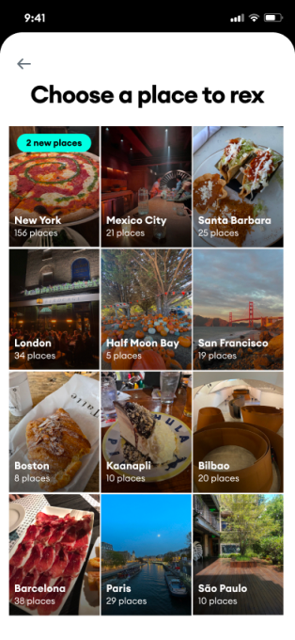
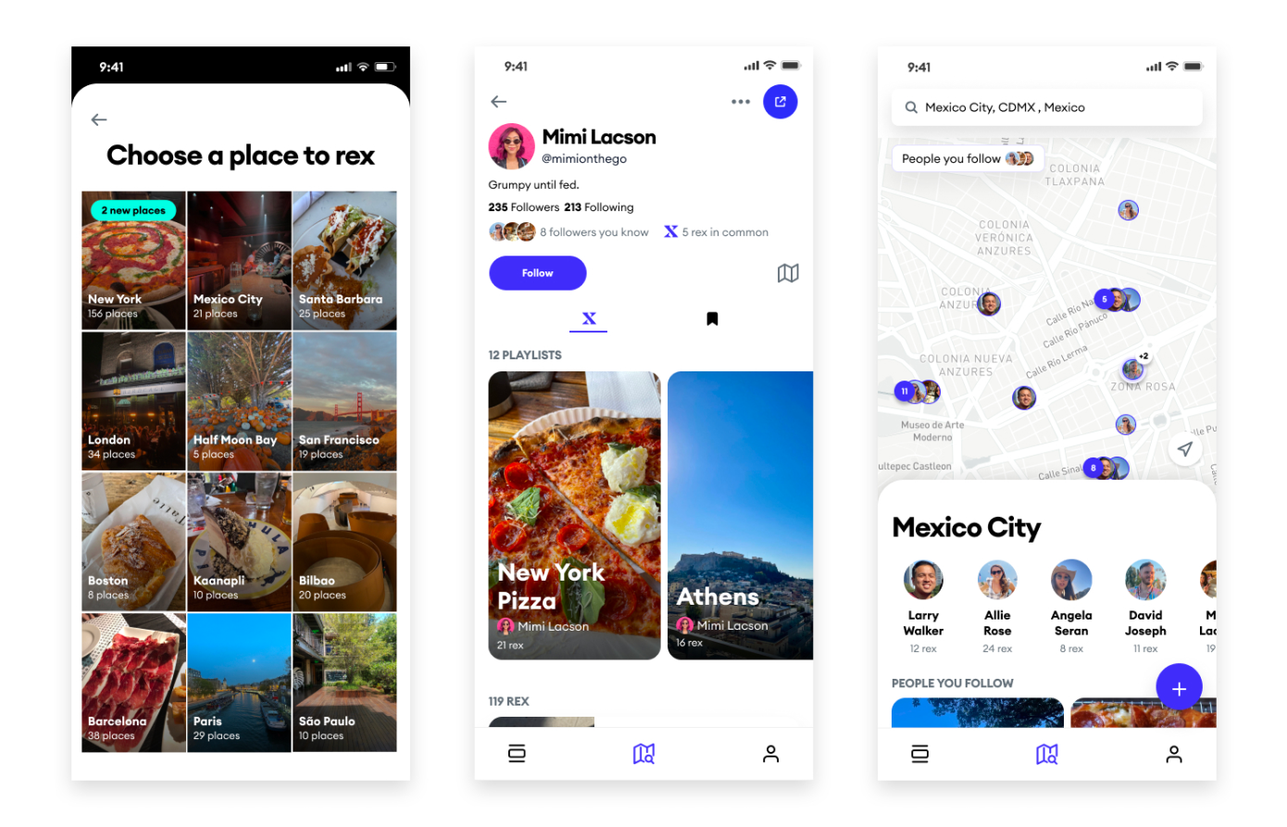
Rex
Travel map with friends
Create and see recommendations and recommendation playlists from friends based on a geographic area
Automatically suggests leaving recommendations by scraping your camera roll to find past restaurants and places you’ve been to

Slide 17
Rex
Travel map with friends
What works for our problem space
What doesn’t work
Tapping into a trustworthy network of friends & friends of friends
Making it easy to share recommendations
People don’t need to leave comments/ratings, just recs
Focus on travel and pleasure
Good quality restaurants, activities, and other forms of entertainment are much easier to come by than good daycares, plumbers, or mechanics

Slide 18
REX TAKEAWAY
Rex tries to fulfill your desires, but Grapevine should focus on fulfilling your needs.

Slide 19
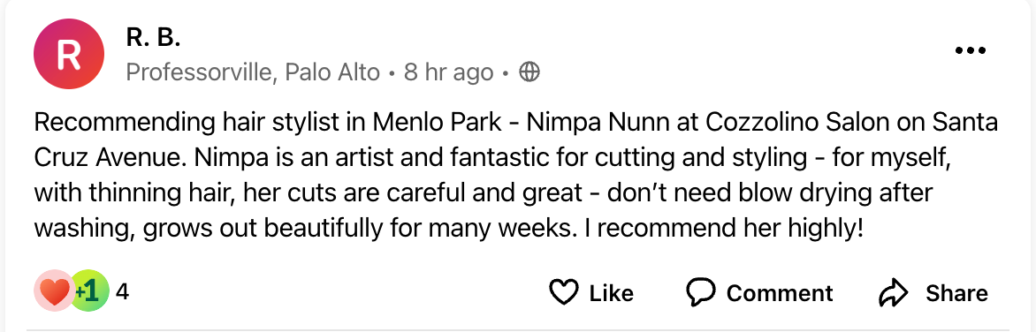
Nextdoor
Neighborhood Network
Private network connecting people living in same neighborhood
Hyperlocal
Open forum for people to post anything, from complaints to recommendations to questions
Recommendation posted on Nextdoor

Slide 20
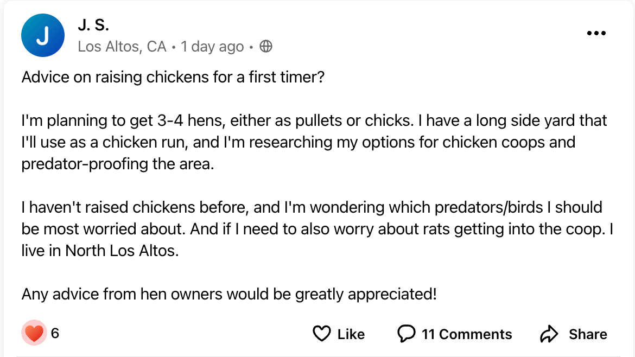
Nextdoor
Neighborhood Network
Private network connecting people living in same neighborhood
Hyperlocal
Open forum for people to post anything, from complaints to recommendations to questions
Question posted on Nextdoor

Slide 21
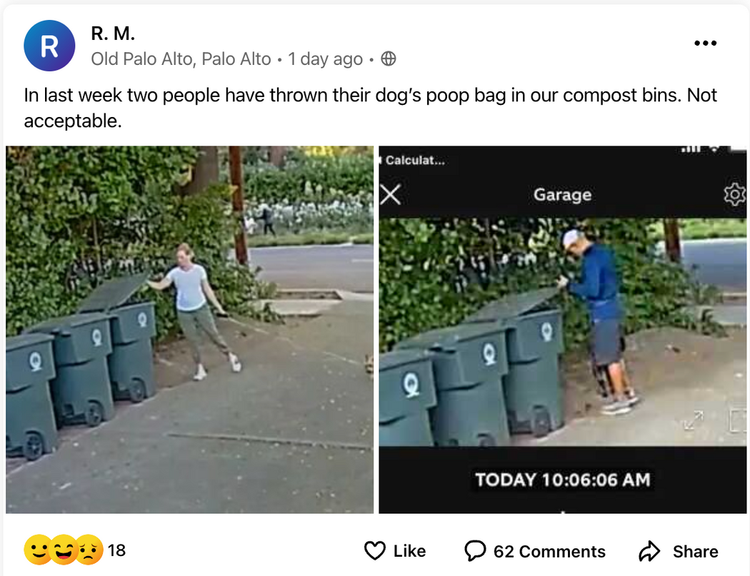
Nextdoor
Neighborhood Network
Private network connecting people living in same neighborhood
Hyperlocal
Open forum for people to post anything, from complaints to recommendations to questions
Complaint posted on Nextdoor

Slide 22
Nextdoor
Travel map with friends
Neighborhood Network
What works for our problem space
What doesn’t work
Creating a network based on commonality, in this case, location
Making it easy to post specific requests and recommendations rather than relying on existing content
Lack of content focus
Nextdoor’s feed is cluttered with a mixture of posts
A shared geographic location is not always enough to qualify someone’s recommendation as relevant or trustworthy to you

Slide 23
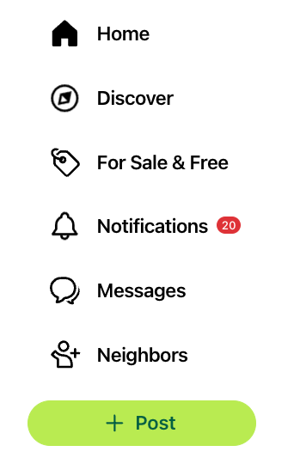
Nextdoor
Travel map with friends
Neighborhood Network
What doesn’t work
Have to explicitly ask and get replies to your asks for recommendations among a sea of other posts
More of a social media platform than a recommendation platform
Dedicated tab for selling things but no tab for recommendations

Slide 24
NEXTDOOR TAKEAWAY
Nextdoor allows you to post anything, which means you can be specific in your requests, but that posts are really disjointed. Grapevine should enable you to be specific with requests while still ensuring that you only see relevant information.

Slide 25
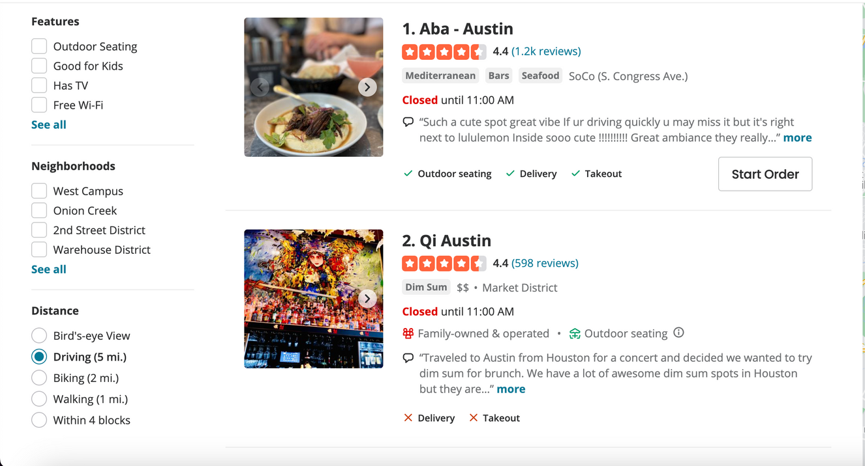
Yelp
Food, Delivery & Reviews
A leading platform for crowdsourced reviews about local businesses, restaurants, shops, and services
Provides businesses with advertising and marketing services to enhance their visibility on the platform

Slide 26
Yelp
Food, Delivery & Reviews
What works for our problem space
What doesn’t work
It is easy to find, filter, and post reviews
Qualifying reviews based on number of past reviews, photos, etc.
Large user base means more business have more reviews
Reputation for being focused on restaurants
The public aspect of Yelp makes it susceptible to fake or commissioned reviews
Yelp highlights businesses that pay for advertisments

Slide 27
YELP TAKEAWAY
Yelp makes it easy to post reviews, and there are an abundance of reviews on the platform, but many are biased, fake, or paid-for. Grapevine should make leaving recommendations easy, but still preserve their trustworthiness.

Slide 28
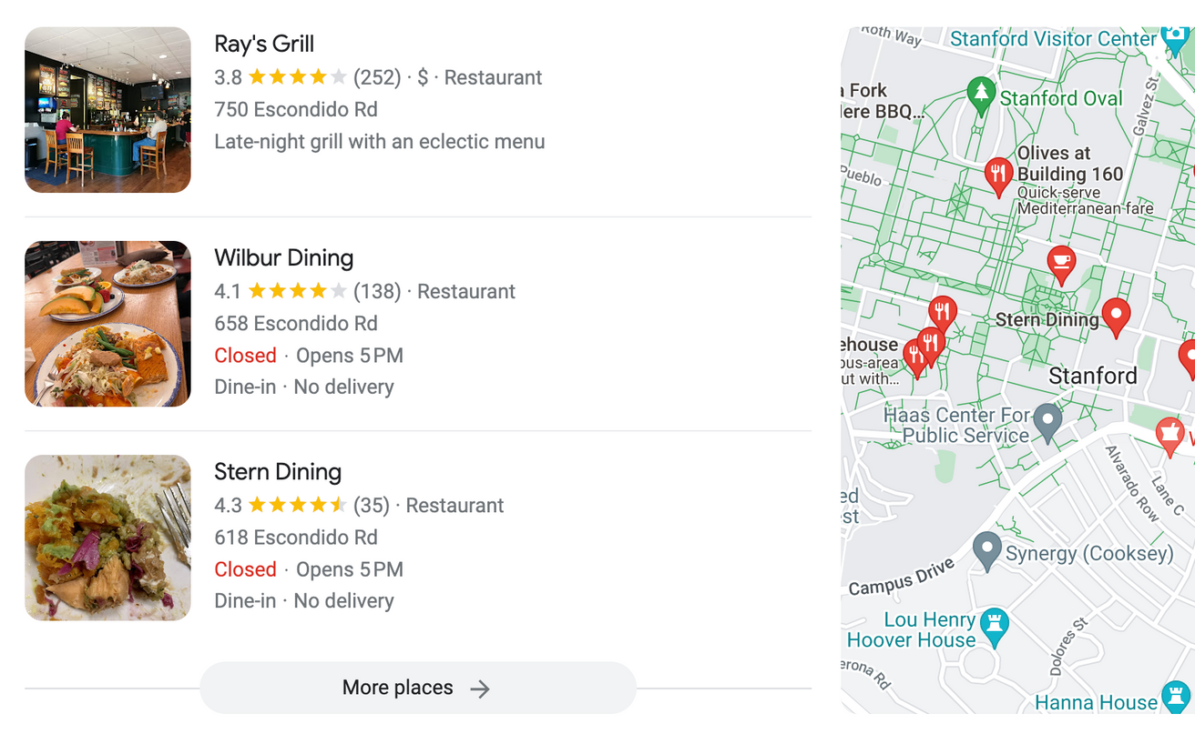
Google
Organizing the world’s information
Leading platform for users to leave public reviews for businesses, products, and services.
Aggregates reviews from various sources across the internet, including its own platform as well as third-party review sites.

Slide 29
Google
Organizing the world’s information
What works for our problem space
What doesn’t work
Similar to Yelp, it is easy to find, filter, and post reviews
Any category of business can be reviewed easily, and there is no niche towards entertainment
Large user base means more business have more reviews
Similar to Yelp, the public aspect of Google makes it susceptible to fake or commissioned reviews
Google also highlights businesses that pay for advertisments

Slide 30
GOOGLE TAKEAWAY
Similar to Yelp, due to the ease of leaving reviwws, Google has an abundance of reviews. However, there is no way to guarantee that the preferences of the reviewers are in any way aligned with yours. Grapevine should make leaving recommendations easy, but still preserve their relevance.

Slide 31




Competitive Analysis
NEEDS
STRANGERS
FRIENDS
WANTS

Slide 32

Competitive Analysis
NEEDS
Whitespace & Gap
in the Market
STRANGERS
FRIENDS
WANTS

Slide 33
Competitive Analysis
NEEDS
STRANGERS
FRIENDS
WANTS

Slide 34
04
Extra Findings

Slide 35
We wanted to make sure there really was a need for our idea that couldn’t be fulfilled by existing solutions.
So we did some more digging on both new and old interviewees, and here’s what we found....

Slide 36
Services aren’t glamorous. Having good song recommendations is indicative of good taste, having a good plumber rec isn’t.
It‘s harder to find or naturally receive good service recommendations than for things like restaurants, music, etc. Why?
Services are used less frequently. How often do you go to a plumber vs a restaurant? Thus, less reviews are available.
Services are a lot more personal and and require more monetary and temporal investment. A bad dish is a bad dish, a bad haircut or bad plumbing job is much more impactful
There are just less options for services. How many mechanics vs restaurants are there in your town?

Slide 37
Places with the best and most reviews are more likely to receive more good reviews just because of visibility, whereas hidden gems may suffer.
People’s preferences don’t always align with those of strangers. Someone from Asia probably thinks the highly rated Asian food in Palo Alto is bad.
Why can‘t people just use existing solutions like Yelp or Google?
Many good recommendations never make it onto these platforms because many people don’t care enough to share their recommendations with strangers online.
Many people don’t trust online reviews after noticing fake reviews.

Slide 38
Asking for a restaurant can indicate that you appreciate that person’s taste or expertise. Asking for a good mechanic can just be annoying.
People are wary of bugging their friends, and individually texting people they know can be a hassle.
Why can‘t people just get good recommendations by asking friends?
Many people just don’t have good recommendations for services. How likely is it that your friend knows a good mechanic vs knows a good restaurant?
People often just struggle to get back to you or have low response rates.

Slide 39
Which leads us back to...

Slide 40
Removes clutter of other categories and focuses on addressing needs
Solution
Can explicitly solicit recommendations instead of just relying on existing content
A service recommendation app where you can see and request recommendations from friends & friends of friends for things like plumbers, mechanics, nannies, etc.
Can get trusted recommendations from a network that extends beyond just direct connections

Slide 41
06
Tasks

Slide 42
Simple:
Reasoning
Finding and reading recommendations
What most users will be using the app for and will take minimal steps

Slide 43
Moderate:
Reasoning
Leaving recommnedations
Filling out
recommendation profile*
Requires initial proactive action & time investment from the user, involves more steps than simply browsing other peoples’ service recommendations
*not demonstrated in video

Slide 44
Complex:
Reasoning
Requesting a recommendation from friends of friends; sharing a recommendation with friends of friends
Connects adjacent networks, happens in multiple steps, and requires coordination between at least two users

Slide 45
05
Values in Design

Slide 46

Stakerholders
Travel map with friends
And Implications
Direct
Indirect
Immediate app users: people who value friend recommendations and are looking for services
Service providers (mechanics, gardeners, dentists, nannies, etc.) who are being recommended by those on the app
App developers/owners
Professionals and/or businesses who are not being recommended on the app
Other review systems (Yelp, Google, Rex)
People who are in the network of app users but not app users themselves
Government regulators dealing with data privacy

Slide 47
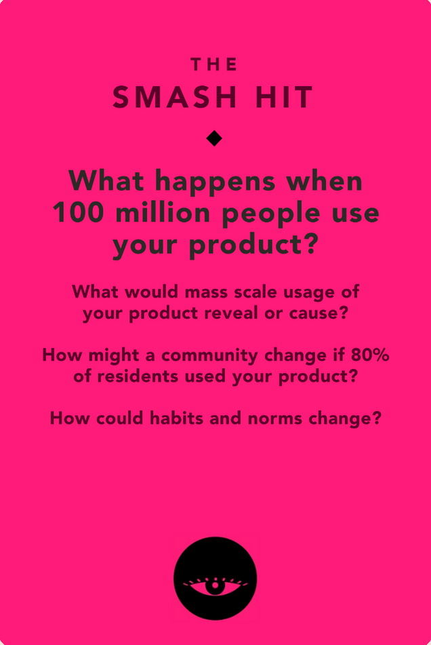
Ethical Consideration #1
As with other recommendations systems, our app may exacerbate the financial and social success between businesses; those doing well will gain more attention, receive better recommendations, and continue thriving. We have chosen not to include bad reviews or “anti-recommendations” so as not further damage poorly reviewed businesses. As a friends-based program, it is also important to consider community echo chambers—is it ideal for everyone to employ the same therapists? People may grow too reliant on services that others have used and liked, which also makes it difficult for new businesses to enter the market.

Slide 48
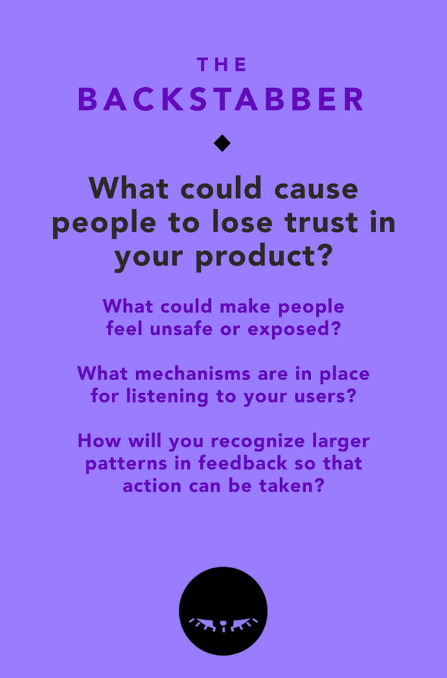
Ethical Consideration #2
While people are generally open to sharing details about their gardener or plumber to their friends, they may not want to say who their doctor or therapist is. It may feel especially uncomfortable to share this personal information with friends’ of friends. Additionally, users may mistrust us, the developers, in terms of managing sensitive health info. In order to make people feel more protected, they only have to upload recommendations they want to share. Users are also asked for permission before passing along recs to friends of friends, as demonstrated in our video.

Slide 49
07
Storyboards & Video

Slide 50
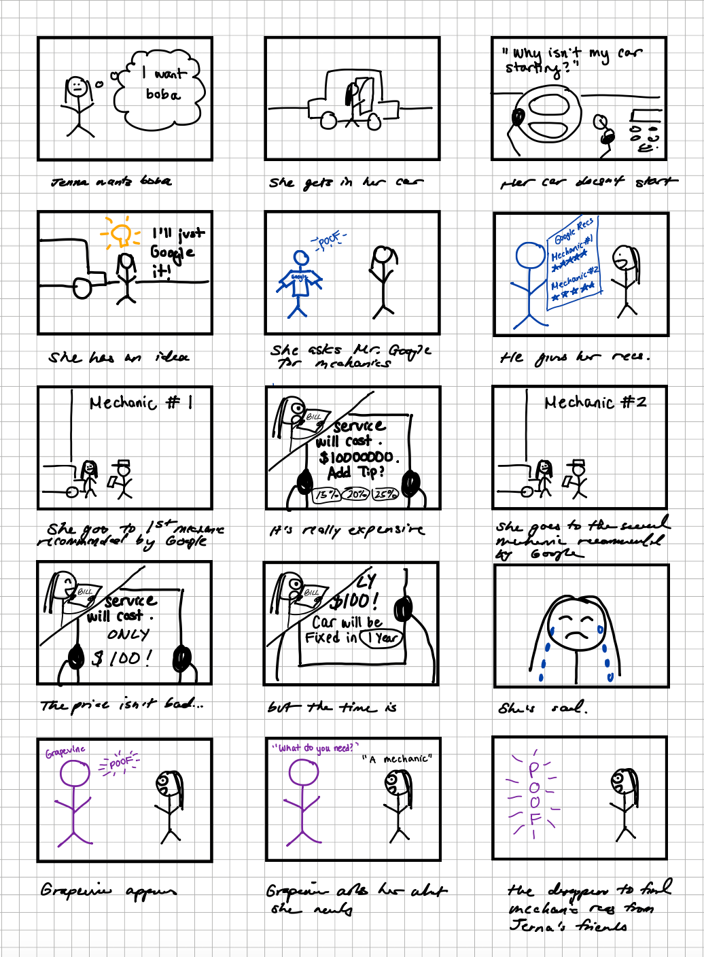

Slide 51
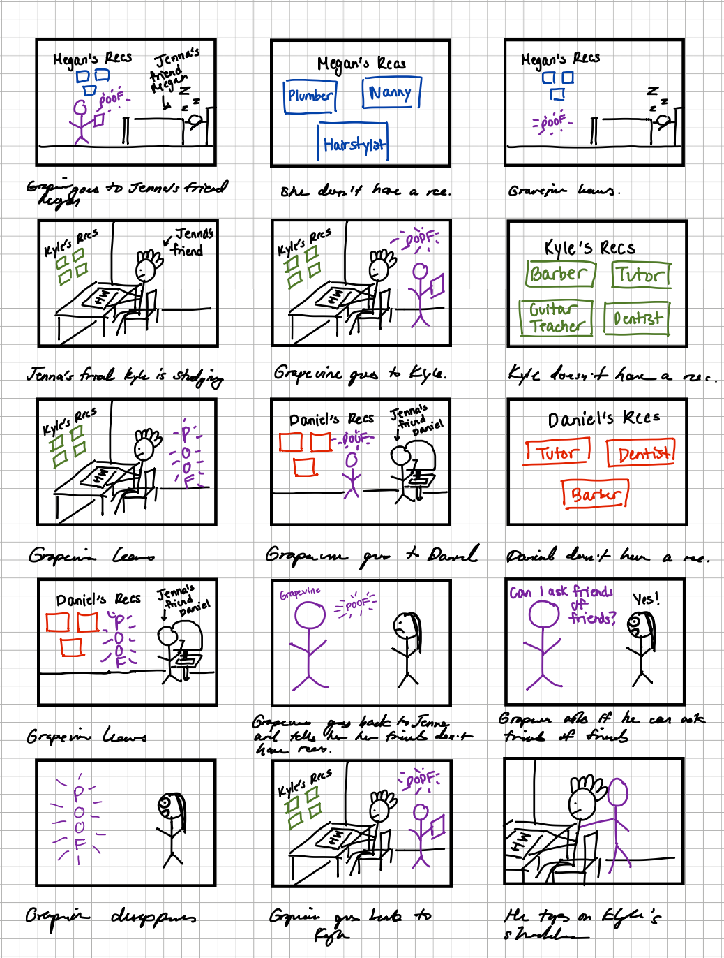

Slide 52
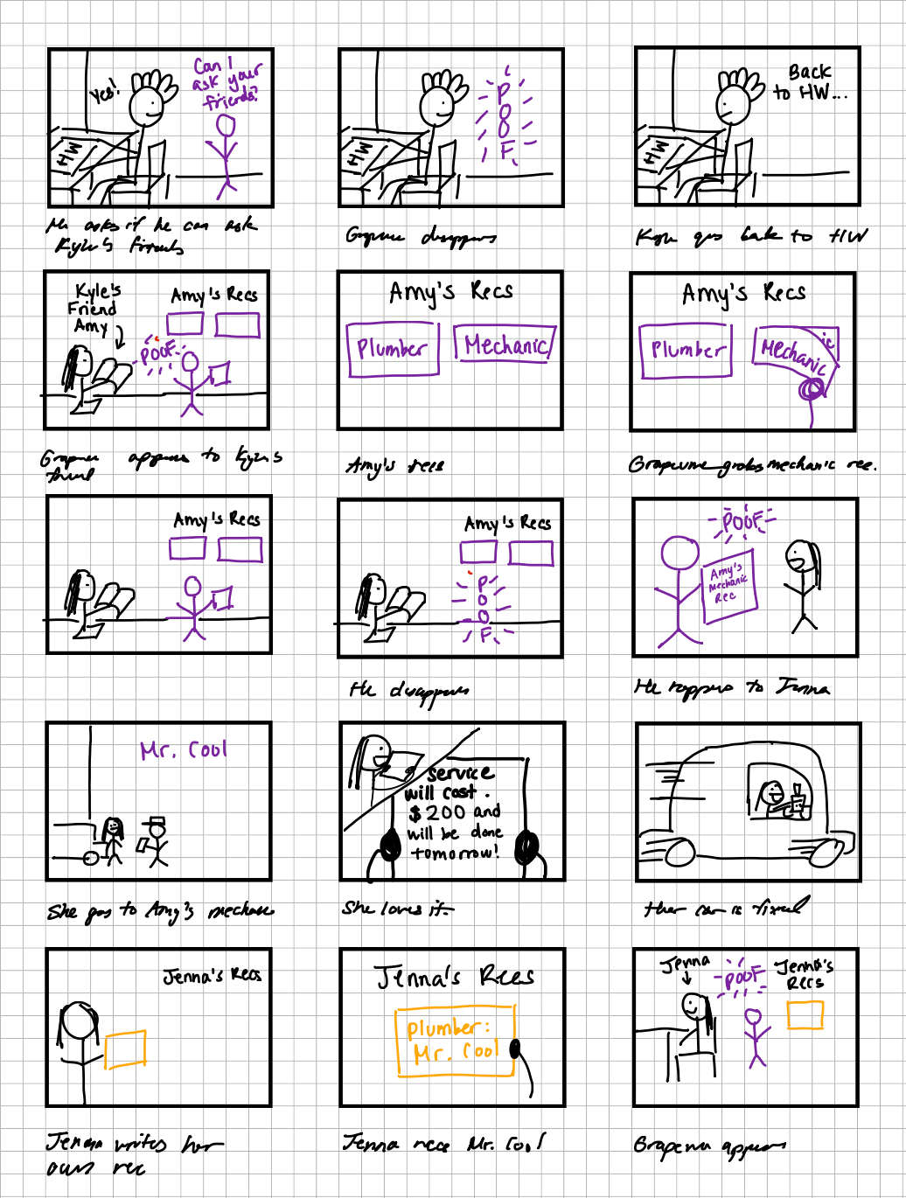

Slide 53
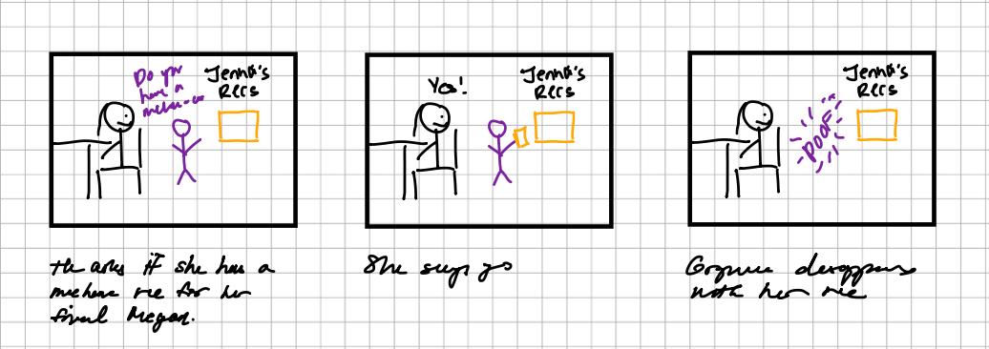

Slide 54
Link to video: https://youtu.be/lRh_K2XxQLI

Slide 55
08
Appendix

